Slide 1

Services science & Service Operational Management – Unit II

Slide 2

What is Services Strategy A Service strategy is a plan to achieve the goals and objectives of a service.

Slide 3
Service Strategy …
Eg: goal - to improve revenue
Strategies – that improve service experience to attract new customers, and slow customer churn.

Slide 4
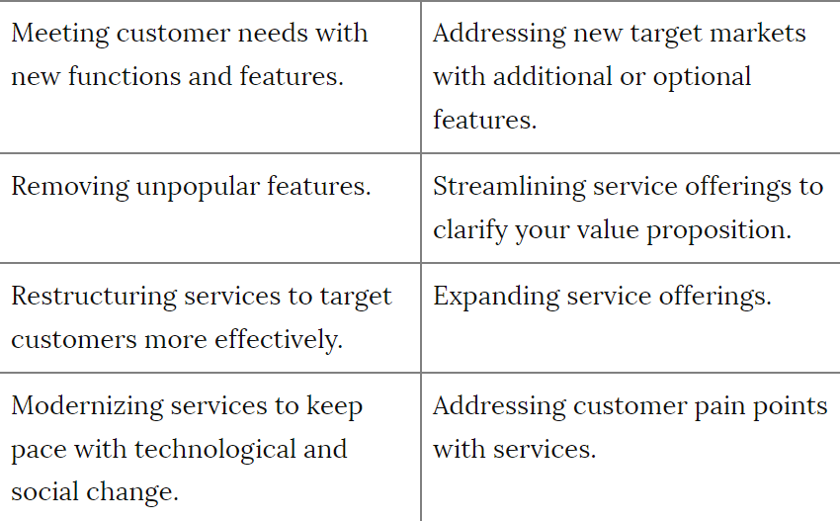
Service strategy

Slide 5
Service Strategic Vision
It consists of
identification of a target market segment,
development of a service concept to address targeted customers’ needs,
codification of an operating strategy to support the service concept, and
design of a service delivery system to support the operating strategy.

Slide 6
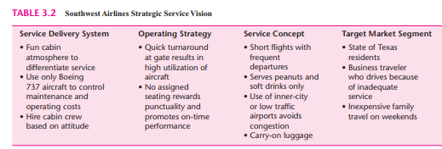
Service Strategic Vision
The links between the service concept and the operating strategies are those policies and procedures by which the company seeks to maximize the difference between the value of the service to customers (the service concept) and the cost of providing it. This difference, of course, is a primary determinant of profit.
And the link between the operating strategy and the service delivery system is the integration achieved in the design of both.

Slide 7
Understanding the Competitive Environment of Services
Relatively low overall entry barriers. Service innovations are not patentable, and in most cases, services are not capital-intensive. Thus, innovations can easily be copied by competitors. However, other types of entry barriers exist, such as locating a resort hotel on the best beach of an island (e.g., the Club Med location on the island of Moorea in French Polynesia).
Minimal opportunities for economies of scale. The necessity of physical travel for many services limits the market area and results in small-scale outlets. Franchised firms can realize some economies of scale by sharing purchasing or advertising costs; in other instances, using the Internet can be a substitute for physical travel (e.g., ordering from Amazon.com).
Erratic sales fluctuations. Service demand varies as a function of the time of day and the day of the week (and sometimes seasonally), with random arrivals. Can you think of some exceptions?

Slide 8
Understanding the Competitive Environment of Services
No advantage of size in dealing with buyers or suppliers. The small size of many service firms places them at a disadvantage in bargaining with powerful buyers or suppliers. Many exceptions should come to mind, however, such as McDonald’s buying beef and Marriott’s buying mattresses.
Product substitution. Product innovations can be a substitute for services (e.g., the home pregnancy test). Thus, service firms must not only watch other service competitors but also anticipate potential product innovations that might make their services obsolete

Slide 9
Understanding the Competitive Environment of Services
Customer loyalty. Established firms using personalized service create a loyal customer base, which becomes a barrier to entry by new services. For example, a hospital supply firm may place its own ordering computer terminals at customers’ sites. These terminals then facilitate the placement of new orders to the extent that competitors are effectively excluded.
Exit barriers. Marginal service firms may continue to operate despite low, or even nonexistent, profits. For example, a privately held firm may have employment of family members rather than maximizing profit as its goal. Other service firms, such as antique stores or scuba diving shops, have a hobby or romantic appeal that provides their owners with enough job satisfaction to offset low financial compensation. Thus, profit-motivated competitors would find it difficult to drive these privately held firms from the market.
New entrants, however, must develop a service strategy that will address the important competitive features of their respective industries.

Slide 10
Competitive Service Strategies
Michael Porter has argued persuasively that three generic competitive strategies exist: overall cost leadership, differentiation, and focus.
Overall Cost Leadership Strategy:
Explanation: This strategy involves being the low-cost provider in the industry, defending against competition and potentially revolutionizing the industry.
Example: McDonald’s is a prime example, offering low-cost fast food globally through efficient-scale facilities, tight cost control, and innovative technology.
Seeking Out Low-Cost Customers:
Explanation: Targeting customers who cost less to serve, often through specific demographics or preferences.
Example: USAA, an automobile insurer, serves only military personnel and their families who are willing to conduct business through cost-effective channels like telephone, mail, or online.
Standardizing a Custom Service:
Explanation: Offering routine professional services at a lower cost by standardizing processes.
Example: H&R Block provides nationwide tax preparation services, focusing on routine tax needs. This model also applies to storefront legal services and family health care centers.

Slide 11
Competitive Service Strategies
4. Reducing the Personal Element:
Explanation: Decreasing personal interactions in service delivery to increase convenience.
Example: The widespread use of ATMs in the banking industry reduces transaction costs by providing customers with convenient access without the need for personal interaction with tellers.
5. Reducing Network Costs:
Explanation: Minimizing network-related costs, especially applicable to service firms requiring a network to connect providers and customers.
Example: Federal Express uses a hub-and-spoke network, with Memphis as a central hub, reducing the need for direct routes between all cities served and allowing cost-efficient expansion to new locations.
6. Taking Service Operations Offline:
Explanation: In certain services where the customer doesn't need to be physically present, the service transaction can be "decoupled," allowing some aspects to be performed offline.
Example: A shoe repair service might establish kiosks for drop-off/pick-up, consolidating orders for delivery to an off-site repair facility, potentially located offshore. This approach leverages economies of scale, cost-effective facility locations, and operates efficiently without the immediate presence of the customer, akin to a factory setup.

Slide 12
Differentiation
Differentiation:
Explanation: The differentiation strategy focuses on creating a unique and distinctive service that stands out in the market. It can take various forms, such as brand image, technology, features, customer service, or dealer network.
Example: American Express differentiates itself through complete travel services, creating a perception of unique offerings that fosters customer loyalty.
Making the Intangible Tangible:
Explanation: Many services are intangible, leaving no physical reminder. Companies enhance the service experience by providing tangible items or additional benefits to remind customers.
Example: Hotels offering complimentary toiletries with the hotel name prominently displayed.

Slide 13
Differentiation
Customizing the Standard Product:
Explanation: Adding personalized touches to a standard service can create a memorable customer experience without significant costs.
Example: Hotels addressing guests by name or hair salons providing personalizing features to differentiate from competitors.
Reducing Perceived Risk:
Explanation: Lack of information about a service can create a sense of risk. Companies alleviate this by providing information, clean facilities, and guarantees.
Example: Auto repair services like Village Volvo that explain work, maintain clean facilities, and offer guarantees to reduce customers' perceived risk.
Giving Attention to Personnel Training:
Explanation: Investing in personnel development and training enhances service quality, creating a competitive advantage that is challenging to replicate.
Example: McDonald's, known for its quality training programs, even has Hamburger University for personnel development.

Slide 14
Differentiation
Controlling Quality:
Explanation: Ensuring consistent service quality across multiple sites requires measures like personnel training, explicit procedures, technology, and supervision.
Example: Magic Pan's use of a foolproof machine to produce consistent crêpes ensures quality across its restaurant chain.

Slide 15
Focus
Focus:
Explanation: The focus strategy involves serving a specific target market exceptionally well by addressing their unique needs. This could be a particular buyer group, service, or geographic region, aiming to outperform competitors in that specific segment.
Example: Motel 6 employs a focus strategy by catering to budget travelers. They provide affordable accommodation with a no-frills approach, meeting the specific needs of cost-conscious customers.

Slide 16
Focus
Importance of Customer Selection:
Explanation: Successful focus strategy relies on effective customer selection. Companies need to carefully choose their target customers and implement policies that align with their specific needs.
Example: A bank in Palo Alto, California follows a focus strategy by targeting wealthy individuals. Policies like closing accounts after bounced checks discourage other customer segments, ensuring a focused approach.

Slide 17
Focus
Davidow and Uttal's Three-Step Approach to Focus:
Segmenting the Market to Design Core Services:
Explanation: Identify distinct segments within the target market and design core services tailored to each segment's specific needs.
Example: Federal Express focuses on people who need guaranteed overnight package delivery, tailoring its core services to meet the time-sensitive demands of this market segment.

Slide 18
Focus
2. Classifying Customers According to the Value They Place on Service:
Explanation: Classify customers based on their perceived value of service, allowing the company to customize offerings for different customer segments.
Example: Shouldice Hospital applies this step by specializing in hernia surgeries, attracting patients who highly value expertise in this specific medical procedure.
3. Setting Expectations Slightly Below Perceived Performance:
Explanation: Manage customer expectations by setting them slightly below perceived performance, ensuring that actual service delivery exceeds what customers anticipate.
Example: Community colleges employ this strategy by positioning themselves as accessible educational institutions, often exceeding the expectations of students who may have initially perceived them as less prestigious.

Slide 19
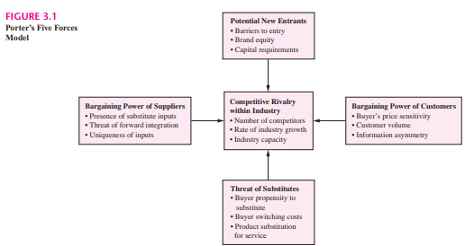
Strategic Analysis
Two popular planning tools include (1) Porter’s five forces analysis of the target industry structure and (2) a SWOT analysis to assess the organization’s strengths, weaknesses, opportunities, and threats in a market.

Slide 20
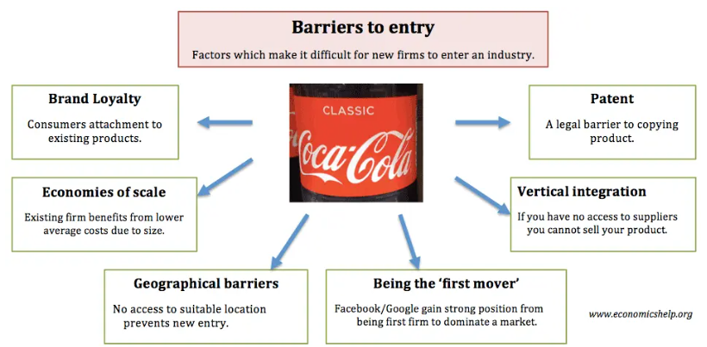

Slide 21
Bargaining power of Buyers
Number of Customers: The total number of buyers in the market can affect their bargaining power. If there are only a few buyers, they may have more negotiating power over suppliers. For example, in a small town with only one grocery store, the residents have limited options and the grocery store has more power to set prices.
Size of Each Customer Order: Larger orders from individual customers can give them more bargaining power. For instance, a company that regularly purchases large quantities of raw materials from a supplier may negotiate lower prices compared to smaller customers.
Differences Between Competitors: Buyers may have more power if there are many competitors offering similar products or services. They can easily switch between suppliers if they find better deals elsewhere. For example, in the smartphone market, buyers have numerous options from different manufacturers, giving them more leverage in negotiations.

Slide 22
Bargaining power of Buyers
3. Price Sensitivity: If buyers are highly sensitive to price changes, they can exert more pressure on suppliers to lower prices. For instance, in industries where products are considered commodities with little differentiation, such as wheat or oil, buyers can easily switch to the supplier offering the lowest price.
4.Buyer's Ability to Substitute: If buyers can easily find alternative products or services that meet their needs, they have more bargaining power. For example, if a consumer electronics store increases the prices of smartphones, buyers may choose to purchase tablets or laptops instead.
5.Buyer's Information Availability: Buyers with access to comprehensive information about products, prices, and market trends can negotiate better deals. For example, consumers who research prices online before making a purchase are better equipped to negotiate discounts or find the best deals.
6.Switching Costs: If there are significant costs associated with switching suppliers, buyers may be less inclined to negotiate aggressively. For example, if a company has invested heavily in integrating a supplier's products into its operations, it may be reluctant to switch suppliers even if prices increase.

Slide 23
Porter’s Five Force Model
Bargaining Power of Suppliers. Suppliers of inputs can be a source of power over the firm because of product uniqueness or monopoly source. The most important suppliers to Netflix are the DVD distributors, but Netflix has considerable leverage because of volume purchases.
Competitive Rivalry within Industry. Often this factor is the major determinant of industry competitiveness. Rivals might be aggressive price competitors or they might use nonprice strategies such as innovation, branding, or superior quality. Industry capacity relative to total customer demand is an important indicator of whether a new entrant will find customers. An exception was Southwest Airlines, which entered the Texas market offering low-cost fares and frequent departures that tapped a latent

Slide 24
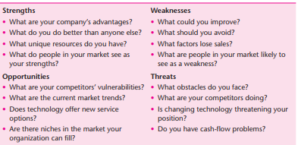
SWOT Analysis: Strengths, Weaknesses, Opportunities, Threats

Slide 25
Winning customers in the marketplace
Availability. How accessible is the service? The use of ATMs by banks has created 24- hour availability of some banking services (i.e., service beyond the traditional “banker’s hours”). Use of 800-numbers and Web sites by service firms facilitate access to information and personal accounts 24/7.
Convenience. The location of the service defines convenience for customers who must travel to that service. Gasoline stations, fast-food restaurants, and dry cleaners are examples of services that must select locations on busy streets if they are to succeed.
Dependability. How reliable is the service? For example, once the exterminator is gone, how soon do the bugs return? A major complaint regarding automobile repair services is the failure to fix the problem on the first visit. For airlines, on-time performance is a statistic collected by the FAA.
Personalization. Are you treated as an individual? For example, hotels have discovered that repeat customers respond to being greeted by their name. The degree of customization allowed in providing the service, no matter how slight, can be viewed as more personalized service.

Slide 26
Winning customers in the marketplace
Price. Competing on price is not as effective in services as it is with products, because it often is difficult to compare the costs of services objectively. It may be easy to compare costs in the delivery of routine services such as an oil change, but in professional services, competition on price might be considered counterproductive because price often is viewed as being a surrogate for quality.
Quality. Service quality is a function of the relationship between a customer’s prior expectations of the service and his or her perception of the service experience both during and after the fact. Unlike product quality, service quality is judged by both the process of service delivery and the outcome of the service.
Reputation. The uncertainty that is associated with the selection of a service provider often is resolved by talking with others about their experiences before a decision is made. Unlike a product, a poor service experience cannot be exchanged or returned for a different model. Positive word-of-mouth is the most effective form of advertising.

Slide 27
Winning customers in the marketplace
Safety. Well-being and security are important considerations because in many services, such as air travel and medicine, the customers are putting their lives in the hands of the service provider.
Speed. How long must I wait for service? For emergency services such as fire and police protection, response time is the major criterion of performance. In other services, waiting sometimes might be considered a trade-off for receiving more personalized services, or in reduced rates.

Slide 28
Winning customers in the marketplace
In the hospitality industry, a key qualifier is cleanliness and hygiene standards.
For example, imagine a new boutique hotel entering the market. While it may offer unique design features, excellent customer service, and competitive pricing, if it fails to meet basic cleanliness standards, such as having dirty rooms or unhygienic bathrooms, it will struggle to attract and retain customers.
Service Winners Service winners are dimensions such as price, convenience, or reputation that are used by a customer to make a choice among competitors. Depending on the needs of the customer at the time of the purchase, the service winner may vary. For example, seeking a restaurant for lunch may be based on convenience, but a dinner date could be influenced by reputation. Note that a service winner can become an industry qualifier (e.g., ATM use by banks).

Slide 29
Service Losers
Service Losers: Failure to deliver at or above the expected level for a competitive dimension can result in a dissatisfied customer who is lost forever. For various reasons, the dimensions of dependability, personalization, and speed are particularly vulnerable to becoming service losers. Some examples might be failure of an auto dealer to repair a mechanical problem (i.e., dependability), rude treatment by a doctor (i.e., personalization), or failure of an overnight service to deliver a package on time (i.e., speed).

Slide 30
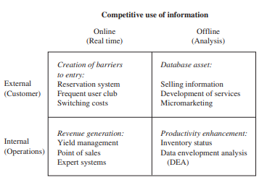
Different roles in which information technology can support a service firm’s competitive strategy

Slide 31
Creation of Barriers to Entry
Creation of Barriers to Entry: Barriers to entry can be created by using economies of scale, building market share, creating switching costs, investing in communications networks, and using databases and information technologies to strategic advantage.
Three uses of information for creating barriers to entry: reservations systems, frequent flyer or similar programs to gain customer loyalty, and development of customer relationships to increase switching costs.
Reservation system:
Airlines: Real-time flight comparison websites like Kayak or Skyscanner allow users to quickly compare prices and availability across different airlines, increasing competition and putting pressure on individual airlines to offer competitive pricing and promotions.

Slide 32
Frequent user club:
Streaming services: Platforms like Netflix or Spotify offer tiered subscription plans with exclusive content or disc
Retail stores: Loyalty programs with points, discounts, and exclusive offers encourage customers to spend more at specific retailers, making it less attractive to switch to competitors.
Switching costs:
Subscription services: Long-term contracts or cancellation fees create a financial barrier to switching providers, particularly for services like gym memberships or software subscriptions.

Slide 33
Revenue Generation
Yield management is a revenue-maximizing strategy used by companies to optimize the utilization of time-perishable resources, such as airline seats or hotel rooms. American Airlines pioneered this approach through its SABRE reservations system, which constantly monitors upcoming flights and competitor offerings to make pricing and allocation decisions on unsold seats. By adjusting the allocation of discounted fares and holding some seats for last-minute full-fare customers, American ensures maximum revenue for each flight. This real-time pricing strategy minimizes empty seats while catering to both bargain-seeking and full-fare passengers. The success of yield management has led to its adoption in various industries, such as hospitality, where companies like Marriott Hotels have implemented similar systems to boost occupancy rates. Additionally, American Airlines has capitalized on its innovation by selling yield management software to non-competing industries like the French national railroad.

Slide 34
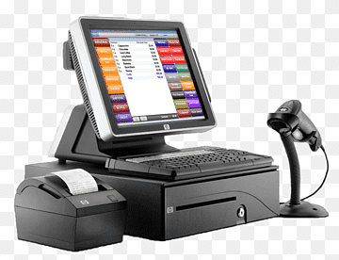
Revenue Generation
Point of Sale (POS) technology has revolutionized the retail and service industries by enhancing customer experience and streamlining operations. Walmart's introduction of the VideOcart exemplifies how innovative POS systems can benefit shoppers and retailers alike. As customers navigate the store with the VideOcart, they receive real-time information about departmental offerings and easily locate desired items through interactive maps displayed on the cart's screen. This not only improves the shopping experience but also drives sales by increasing customer engagement and satisfaction. Similarly, in the restaurant industry, the use of palm-sized microcomputer transmitters enables servers to transmit orders directly to the kitchen and bills to cashiers simultaneously. This efficient communication reduces unnecessary steps, expedites service, and provides opportunities for suggestive selling, ultimately enhancing the overall dining experience. These examples highlight the transformative impact of POS technology in enhancing operational efficiency and customer satisfaction across various retail and service sectors.

Slide 35
Revenue Generation
Expert systems, such as those implemented by Otis Elevator Company, utilize advanced technology to enhance operational efficiency and problem-solving capabilities. By collecting and integrating vast amounts of data on elevator behavior, Otis has developed a knowledge base incorporated into expert systems accessible via laptop computers by maintenance staff in the field. This enables repair personnel to quickly diagnose elevator issues and expedite repairs, resulting in improved elevator uptime and reduced reliance on repair personnel. Similarly, expert systems have been applied in various industries, including medicine and oil exploration, to provide diagnostic assistance and identify optimal solutions. Overall, the implementation of expert systems represents a significant advancement in leveraging technology to streamline operations and enhance decision-making processes across diverse sectors.

Slide 36
Database Asset
Selling Information: Dun & Bradstreet Dun & Bradstreet leverages its extensive database of business credit information to offer valuable insights to businesses. By providing access to its database, Dun & Bradstreet enables companies to make informed decisions about credit and risk management.
Developing Services: Club Med Club Med utilizes its database of member characteristics to tailor its services to evolving customer preferences. For instance, upon realizing that many of its once-single members had transitioned to married life with children, Club Med adapted its resort offerings to cater to families. By creating family-friendly amenities and activities, such as supervised children's programs, Club Med attracts and retains customers at different life stages.

Slide 37
Database Asset
Micromarketing involves tailoring marketing efforts to specific individuals or small groups of consumers based on detailed data analysis. One example of micromarketing is when Borden Inc. and Kraft USA utilized consumer buying information obtained through barcode and checkout scanner technology to target customers more effectively. Borden Inc. used this data to identify stores where its premium pasta sauce would likely perform well, leading to increased sales. Similarly, Kraft USA adjusted its cream cheese flavors to match the preferences of shoppers at particular stores, resulting in higher sales.

Slide 38
Productivity enhancement
Productivity enhancement through the collection and analysis of information is exemplified by Frito-Lay's use of hand-held computers for inventory management. By eliminating paper forms and enabling daily data uploads to headquarters, Frito-Lay ensures optimal inventory levels, pricing accuracy, and product promotions. This real-time data tracking minimizes losses from stale products and facilitates route consolidation, leading to significant cost savings of over $40 million in the first year alone.
Data Envelopment Analysis (DEA) offers a method for evaluating organizational efficiency, as demonstrated by its application to a 60-unit fast-food restaurant chain. Banker and Morey utilized DEA to identify 33 efficient units within the chain by analyzing multiple inputs (such as supplies, labor, and store demographics) against outputs (food sales for breakfast, lunch, and dinner). By comparing the practices of efficient units with less efficient ones, areas for improvement can be identified, fostering organizational learning and driving a competitive strategy of cost leadership.

Slide 39
Virtual Value chain
First Stage (New Processes):
In this stage, businesses focus on improving their physical operations by integrating information technology. USAA transitioned from a manual, paper-based filing system to a centralized computerized database accessible via desktop terminals. This shift allowed them to streamline their operations, reduce paperwork, and improve efficiency by digitizing their processes.
Second Stage (New Knowledge):
Here, virtual alternatives replace physical activities through automation and information systems. USAA automated core business functions such as insurance sales and underwriting. They captured extensive customer information and eliminated the need for a traditional sales force, conducting all business through telephone, mail, or the internet. This approach enabled USAA to tailor products and services to individual member needs based on their comprehensive database.

Slide 40
Virtual Value chain
Third Stage (New Products):
In this stage, businesses analyze accumulated information to develop new products and services tailored to customer needs. USAA used their database to create member risk profiles and customize insurance policies. They identified evolving member needs and introduced new products such as property and casualty insurance, banking services, and investment options. By anticipating individual member needs, USAA enhanced customer satisfaction and loyalty.
Fourth Stage (New Relationships):
In the final stage, businesses explore opportunities for customer collaboration in value creation. USAA engaged retired and active-duty members by offering web-based investment planning tools and interactive seminars on financial topics. This collaborative approach allowed USAA to build stronger relationships with members and provide personalized financial guidance.

Slide 41
New Service Development
The process of new service development (NSD) involves several key stages and factors:
Idea Generation: Ideas for new services can come from various sources, including customer suggestions, frontline employee insights, customer databases, demographic trends, and technological advancements. These ideas form the initial input for the NSD process.
Development Stage: In this stage, new ideas are screened, and promising concepts are developed and tested for feasibility. Concepts that pass this stage move forward to the analysis phase.
Analysis Stage: Here, concepts are further evaluated to determine their potential as profitable business ventures. Factors such as market demand, competition, cost, and potential return on investment are assessed.

Slide 42
New Service Development
Design Phase: Successful concepts from the analysis stage undergo detailed design and development to create the new service product and process. Considerable resources are invested in this phase to ensure that the service meets customer needs and can be effectively delivered.
Field Testing: Once designed, the new service is tested in a real-world setting, typically in a specific city or region. This phase involves personnel training, marketing campaigns, and gathering feedback from customers to refine the service further.
Full Launch: After successful field testing, the new service is launched on a broader scale, either nationally or worldwide. This stage marks the official introduction of the service to the market and involves scaling up operations to meet demand.

Slide 43
NSD
Throughout the NSD process, several enablers drive innovation and facilitate successful service development.
These enablers include cross-functional teams, which bring together diverse expertise and perspectives, tools such as spreadsheets for data analysis and project management, and an organizational culture that fosters innovation and accepts risk-taking.
By leveraging these enablers effectively, organizations can navigate the complex process of new service development and bring innovative offerings to market.

Slide 44
NSD
Service Product Components:
People: Employees and customers are integral components of the service product. Employees must be recruited, trained, and empowered to deliver excellent service. For example, Barnes & Noble empowers its employees with computer access to books in print to assist customers effectively.
Systems: Various systems are essential to accomplish tasks in service delivery. Back-office systems, such as patient records systems in healthcare clinics, support customer-facing employees. Front-office systems, like online hotel booking platforms, interface directly with customers to facilitate service transactions.

Slide 45
NSD
Role of Technology in Service Innovation:
Technological Advances: Technology often drives service innovation by enabling new ways of delivering value to customers. For instance, advancements in power/energy, physical design, materials, methods, and information have led to significant improvements in various industries.
Examples of Technology-Driven Service Innovations:
Power/Energy: The introduction of renewable energy sources, such as solar and wind power, has revolutionized the energy sector by providing cleaner and more sustainable alternatives to traditional fossil fuels.
Physical Design: Innovative architectural designs and building materials have transformed the hospitality industry, leading to the construction of eco-friendly hotels and resorts that prioritize sustainability and environmental conservation.
Materials: The development of lightweight and durable materials has revolutionized product manufacturing and transportation industries, leading to the production of more efficient and environmentally friendly vehicles and packaging solutions.
Methods: Automation and robotics have streamlined processes in manufacturing, logistics, and healthcare, resulting in increased efficiency, accuracy, and productivity.
Information: Advanced data analytics and artificial intelligence technologies have revolutionized various sectors, including finance, healthcare, and retail, by providing insights into customer behavior, optimizing operations, and personalizing service offerings.

Slide 46
NSD
Importance of Technology Monitoring:
Competitive Advantage: Service firms must monitor technological advancements to stay competitive in the market. Companies like Amazon.com have demonstrated that being a technology first-mover can lead to building a loyal customer base and gaining a significant competitive advantage.
In summary, the integration of people, systems, and technology is crucial for delivering excellent service and driving innovation in service industries. By leveraging technological advancements and continuously monitoring new developments, service firms can enhance their offerings, improve operational efficiency, and maintain a competitive edge in the market.

Slide 47
Service Design elements - Structural
These design elements must be engineered to create a consistent service offering that achieves the strategic service vision
Delivery system: This refers to the process of how a service is delivered to the customer. An example of a delivery system is a restaurant's ordering and fulfillment process. The restaurant's delivery system might involve taking orders online or in person, preparing the food, and then delivering it to the customer.
Facility design: This refers to the physical layout of the space where a service is provided. An example of facility design is the layout of a hospital. A hospital's facility design might include separate areas for different departments, such as the emergency room, the intensive care unit, and the maternity ward.

Slide 48
Service Design elements - Structural
Location: This refers to the physical location of where a service is provided. An example of location is the decision of where to open a new store. A retailer might consider factors such as the availability of space, the demographics of the surrounding area, and the proximity to competitors when choosing a location.
Capacity planning: This refers to the process of forecasting demand for a service and ensuring that there are enough resources to meet that demand. An example of capacity planning is an airline's decision of how many flights to schedule. An airline might consider factors such as historical demand, seasonality, and competitor offerings when making capacity planning decisions.

Slide 49
Service Design elements - Managerial
Information: This refers to the information that is needed to design, deliver, and manage a service. An example of information is customer data. A company might use customer data to understand customer needs and preferences, and to develop targeted marketing campaigns.
Quality: This refers to the overall quality of a service. An example of quality is the level of customer satisfaction. A company might track customer satisfaction metrics, such as net promoter score (NPS), to measure the quality of its service.
Service encounter: This refers to the interaction between a customer and a service provider. An example of a service encounter is a customer calling a customer service hotline. A company might train its customer service representatives to be helpful, polite, and efficient in order to create positive service encounters.
Managing capacity and demand: This refers to the strategies that a company can use to manage the supply and demand for its services. An example of managing capacity and demand is a restaurant's use of reservations. A restaurant might use reservations to control the number of customers that it can serve at any given time.

Slide 50
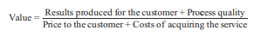
Customer Value Equation
To ensure acceptance of a new service innovation, the design process should take a customer-centric view of what is important.
Results Produced for the Customer:
Customers seek services to address specific needs or desires.
Examples: A restaurant must provide a satisfying meal, and a gasoline service meets the maintenance needs of a vehicle.

Slide 51
Customer Value Equation
Process Quality:
The manner in which a service is delivered is equally important to the customer experience.
Examples: Online book shopping offers convenience compared to visiting a physical store. Improvements in service processes should align with customer preferences, even if they involve trade-offs like installing neighborhood postal boxes instead of door-to-door delivery.
Price to the Customer:
There should not necessarily be a trade-off between cost and quality in services.
Examples: Consistency in service quality can lead to lower costs, as customer perceptions align more closely with expectations. Self-service options, such as online ticket booking, can reduce service costs for businesses and provide value to customers.
Cost of Acquiring the Service:
Customer interest in the cost of acquiring a service extends beyond the price alone.
Examples: Convenience, such as avoiding the hassle of visiting a physical store, holds value to customers. Lowering the acquisition cost, including factors like shipping fees, can be a competitive strategy for service providers.

Slide 52
Strategic Positioning through Process Structure
Preparing the service blueprint is the first step in developing a service process structure that will position a firm in the competitive market. Decisions still remain on the degree of complexity and divergence desired in the service. G. Lynn Shostack defined these concepts and used them to show how a service firm can position itself on the basis of process structure
Degree of Complexity and Divergence:
Complexity: Refers to the number and intricacy of steps in the service delivery process.
Divergence: Refers to the degree of freedom or discretion allowed at each step of the service process.
Example: Preparation of a gourmet dinner at a fine restaurant involves high complexity, while preparing a take-out order at a fast-food restaurant is less complex.
Low-Divergence Strategies:
Firms like H & R Block cater to middle-class taxpayers by offering low-divergence tax services for standard tax returns.
Low divergence allows for consistent quality at reduced costs, with narrowly skilled employees performing routine tasks.

Slide 53
Strategic Positioning through Process Structure
High-Divergence Strategies:
Hair-styling salons for men offer high-divergence services, providing personalized experiences that customers are willing to pay extra for.
High divergence involves customization and personalization to meet individual customer needs.
Specialization and Focused Strategies:
Narrowing the scope of a service through specialization results in low complexity.
Examples include specialty shops selling unique or high-quality products, such as ice cream, cookies, or coffee.
Adding More Services for Market Penetration:
Adding more services increases the complexity of the service structure.
Supermarkets evolving into superstores by offering additional services like banking, pharmacies, and food preparation exemplify this strategy.
Repositioning Strategies:
Repositioning involves changes in both complexity and divergence to meet evolving market demands.
Example: A family restaurant might adopt a strategy combining changes in complexity (e.g., introducing a wider range of menu items) and divergence (e.g., offering customizable options) to attract new customers and retain existing ones.

Slide 54
Service BluePrinting
Service Blueprint as a Design Tool:
Similar to architectural blueprints for buildings, a service blueprint visually represents the service delivery system.
It serves as a map or flowchart of all transactions involved in the service delivery process, helping to design services effectively.
Identification of Customer Transactions:
The blueprint highlights customer-initiated steps, choices, and interactions during the service process.
It helps identify potential fail-points or areas where mistakes could occur, such as taking a food order accurately.
Consideration of Physical Evidence and Customer Expectations:
Physical evidence, including the hotel exterior, room decor, and staff uniforms, is depicted at the top of the blueprint.
Management evaluates whether the physical evidence aligns with customer expectations and the hotel's image.

Slide 55
Service BluePrinting
Customer-Initiated Steps and Service Encounters:
Customer actions are illustrated above the "line of interaction," representing direct interactions with the organization.
Questions arise about how customers should interact with staff and whether different staff members require specific interpersonal skills.
Employee Actions Onstage and Backstage:
Actions performed in full view of the customer are depicted above the "line of visibility" (onstage), such as checking in and receiving luggage.
Below the line of visibility (backstage), activities are not seen by the customer, such as taking food orders over the telephone.
Considerations include appropriate backstage staffing to avoid delays in onstage service delivery.

Slide 56
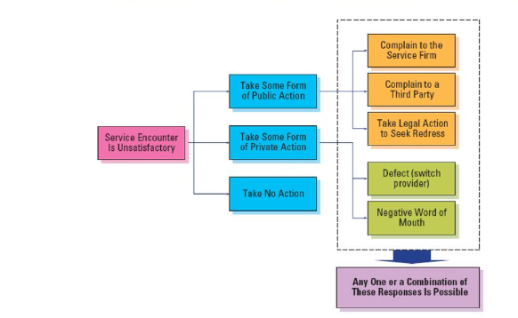
Complaint handling and Service Recovery
Recognize the actions that customers may take in response to service failures.

Slide 57
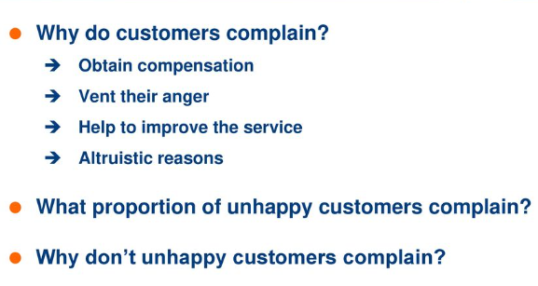
Understanding Customer responses to Service Failures

Slide 58
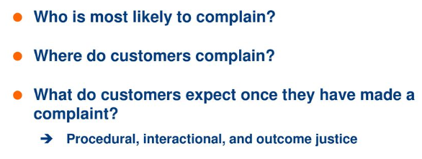
Understanding Customer responses to Service Failures

Slide 59
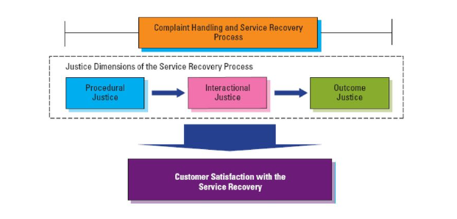
Three dimensions of Perceived fairness in Service Recovery

Slide 60
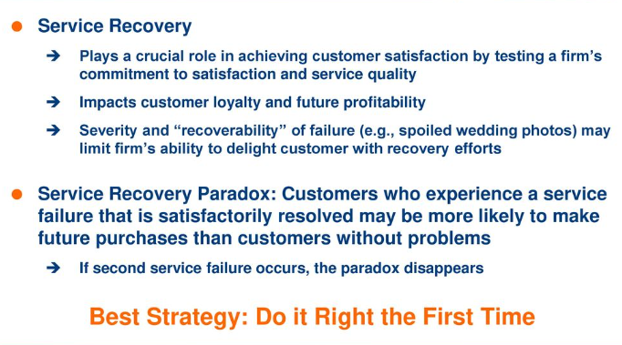
Customer Responses to Effective Service Recovery

Slide 61
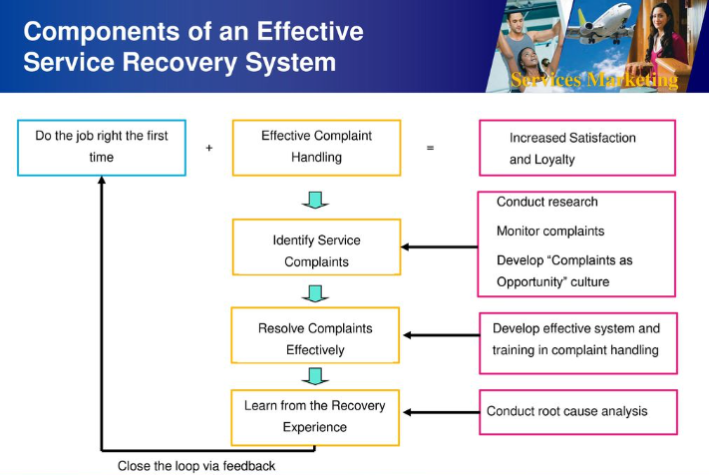
Principles of Effective Service Recovery Systems

Slide 62
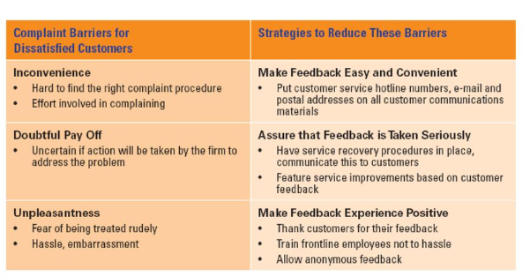
Strategies to reduce customer complaint barriers

Slide 63
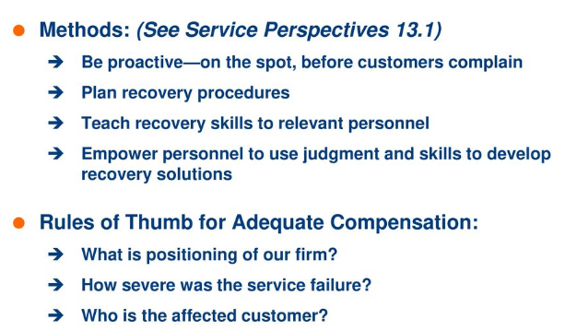
How to enable effective Service Recovery

Slide 64
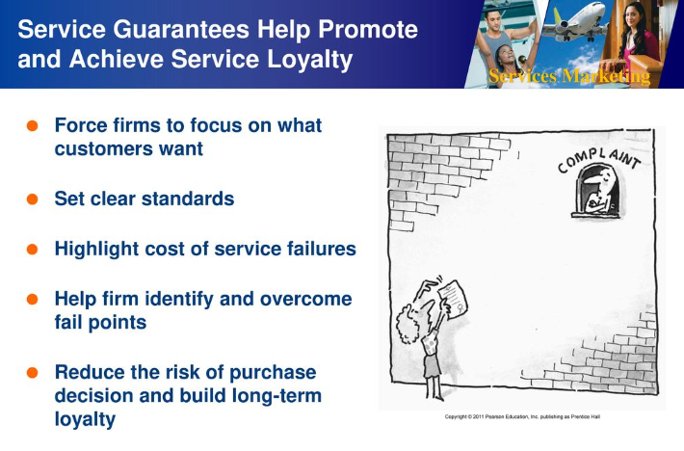
Service Guarantees

Slide 65
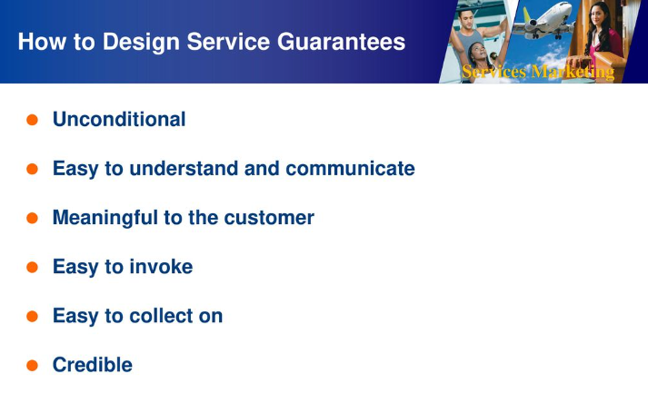

Slide 66
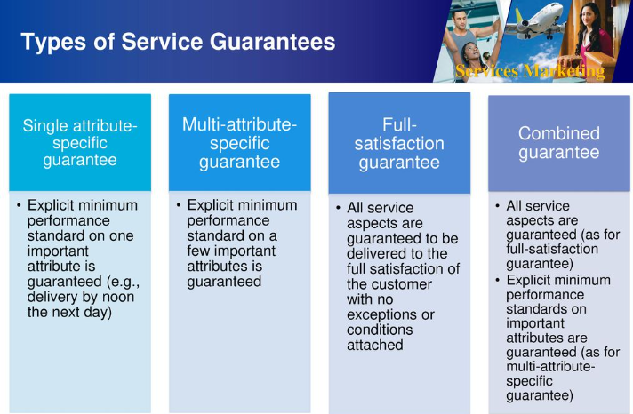

Slide 67
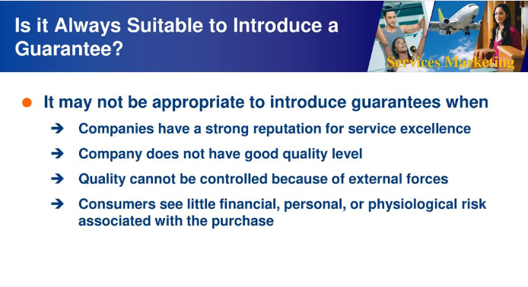

Slide 68
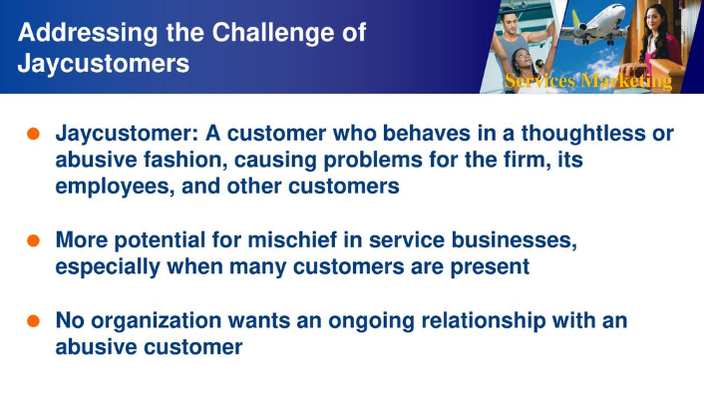
Discouraging Abusive and Opportunistic Customer Behaviour

Slide 69
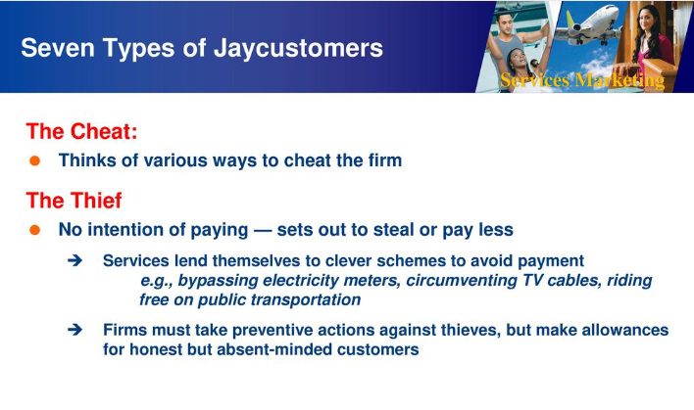

Slide 70
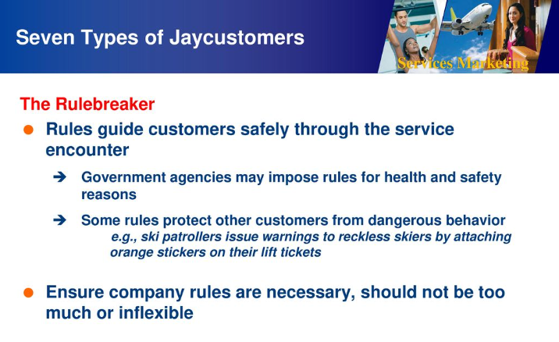

Slide 71
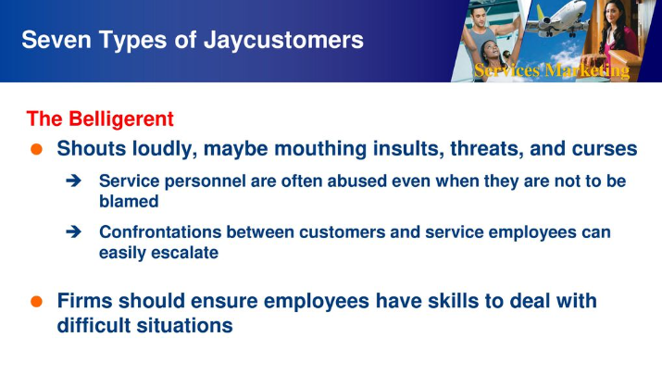

Slide 72
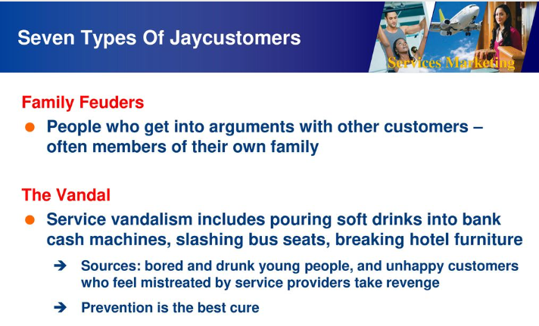

Slide 73
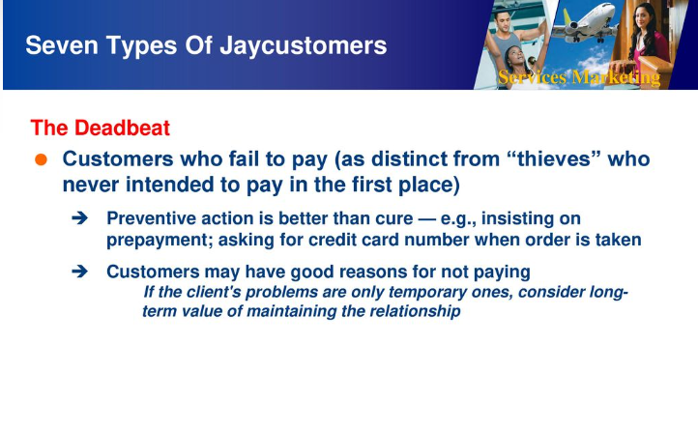

Slide 74
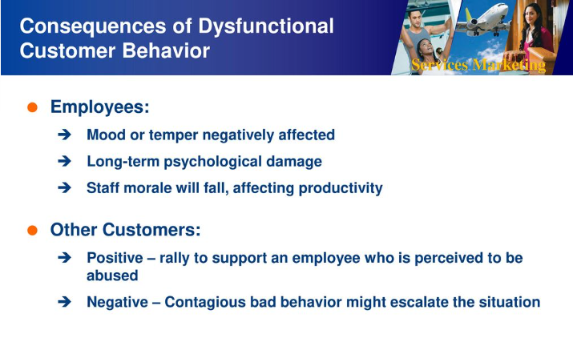

Slide 75
